Slide 1

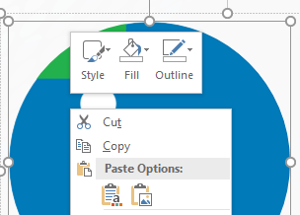
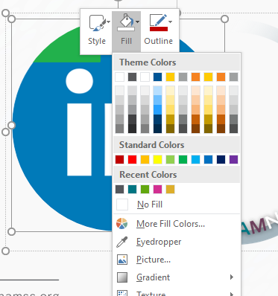
How to use the filters
Showcase your NAMSS pride during Celebrating Diversity Month with #IAMNAMSS filters by following these steps.
1) Double click the green triangle to highlight the placeholder image.
2) Right click the image to access the Fill option.
3) Select Picture to choose your image saved to your computer.

Slide 2

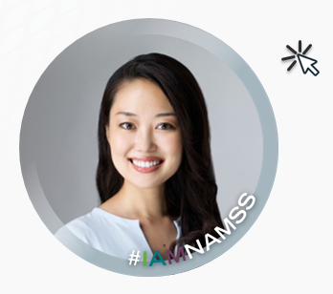
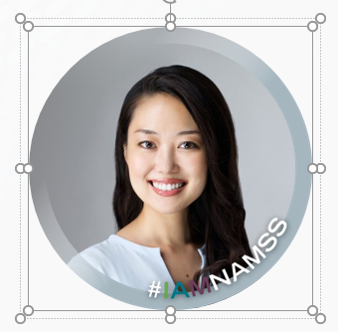
How to use the filters
4) Double click the filter to highlight it.
5) Use the arrows on your keyboard to move the filter over your image.
6) Click outside of your image to admire your work.

Slide 3
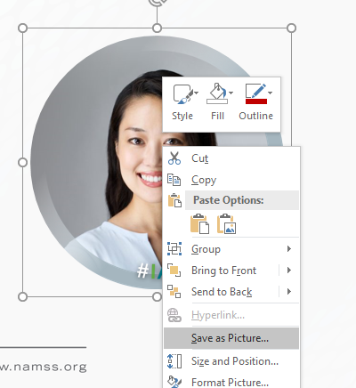
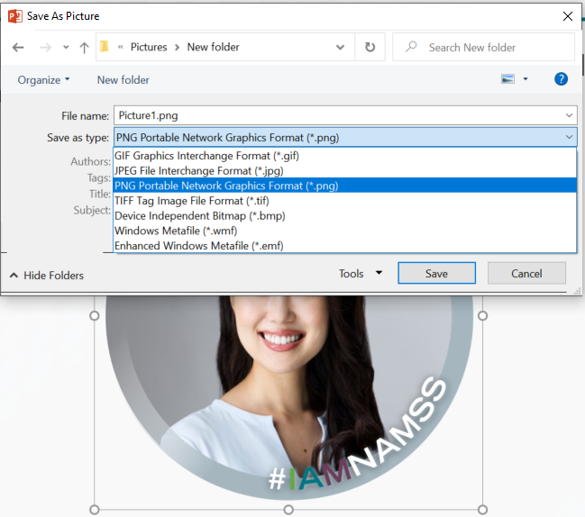
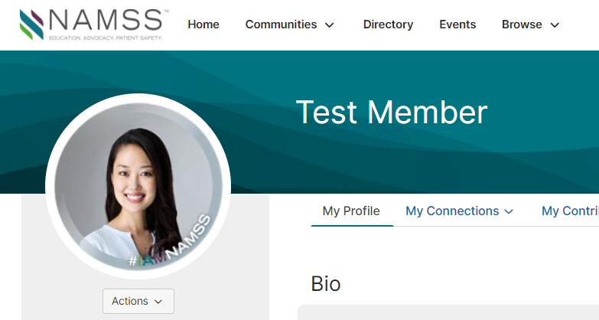
How to use the filters
7) Right-click image and select Save as Picture.
8) Save your new picture to your computer by selecting a name and desired file type.
9) Upload your picture to your social media profile.

Slide 4




Sample pictures

Slide 5


Connection Zone or LinkedIn Profile
Please note: Your picture should be cropped into a square before replacing the placeholder image.

Slide 6


Facebook or Instagram Profile
Please note: Your picture should be cropped into a square before replacing the placeholder image.

Slide 7


Social Media Posts

Slide 8


Social Media Posts

